Slide 1


CSE240
Introduction to Programming Languages
Chapter 2
The Imperative Languages C/C++
Lecture 14
Recursive Structures and Applications
Reading: Textbook Section 2.8
Dr. Yinong Chen

Slide 2
Chapter 2 Outline
Imperative language C/C++
Getting started with C/C++ programming: I/O
Data declaration and scope rules
Basic data types; Basic computer organization
Arrays and strings
Pointer Basics
Pointers, Arrays, and Strings
Pointer and Constants, Enumeration, Struct of Arrays
Padding, File System, and Buffer Flushing
Linked List
Parameter Passing
Recursive Structures and Applications
Examples of recursion and structures
Modules and Packages
Summary

Slide 3
General Structure of Iteration and Recursion
Reading: Text Section 2.7
n
2
1
n
2
1
n
2
1
condition
condition
condition
loop-body
part 1
part 1
Jump to
recursive call
recursive call
n times
n
2
1
part 2
(a)
(b)
(c)
while-loop
recursion
tail-recursion

Slide 4
Merge Sort and Trace of Merge Sort
If the array has only one element, stop.
Split the array into two sub-arrays,
Make two recursive calls, and
Merge the two sorted sub-arrays
A
5 2 4 6 1 3 2 6
5 2 4 6 1 3 2 6
5 2 4 6 1 3 2 6
5 2 4 6 1 3 2 6
5 2 4 6 1 3 2 6
2 5 4 6 1 3 2 6
2 4 5 6 1 2 3 6
1 2 2 3 4 5 6 6
split
B1
5 2 4 6
1 3 2 6
B2
sort
B1
2 4 5 6
1 2 3 6
B2
merge
B
1 2 2 3 4 5 6 6
Not the approach to take here

Slide 5
Structure of Merge Sort
3
1
2
m
n
2
1
condition
1
part 1
part 1
recursive call
2
n times
4
7
part 2
recursive call
n
2
1
m times
5
1
2
m
part 3
6

Slide 6

Analogy
Child: I do not know how to get the flower. It is too high for me.
Mother: Let’s get to step 1. The child did and excited.
The child is about to move to the next step, but,
Mother says: “I know you can make step 2, I don’t want you get bored and tired”.
Mother carries her to step n-1;
Mother lets the child to decide what to do.
Child moves from step n-1 to step n to get the flower.

Slide 7
The Fantastic Four Abstract Approach
of Writing Recursive Functions
Formulate the size-n problem.
Find the stopping condition and the corresponding return value.
Formulate the size-m (m <n ) problem and find m. In many cases, m = n - 1;
Construct the solution of size-n problem from size-m problem.
Review you MAT 243 (Discrete Math) on induction!
For example: https://www.youtube.com/watch?v=0g68EbJT9XM

Slide 8
Step 1: Formulate the size-n problem
Like loop, recursion is necessary only if we want to solve a problem that needs to repeat the same operations for a number of times.
We assume the number of iterations is n. In most cases, n is obvious. For example, if we want to compute factorial n!, the size n is already given.
Formulating size-n problem, in many cases, is merely choosing a function name and using n as the parameter of the function. Thus, the size-n problem for factorial problem is int factorial (int n) // just like the forward declaration
The return value of the size-n is what the function is supposed to compute, or the value we are looking for. Obviously, in this step, we do not need to design the solution for size-n problem.

Slide 9
Step 2: Find the stopping condition and the corresponding return value
Like a while-loop, a recursive function starts with checking the stopping condition.
If the stopping condition is true, we return the corresponding value and exit the function.
Otherwise, we enter the body of the recursive function.
In most cases, identifying the stopping condition and corresponding value is trivial. For example, the stopping condition of factorial(n) is n = 0 and the corresponding value is 1

Slide 10
Step 3: Formulate the size-m problem, m < n
The size-m problem is simply the size-n problem with n replaced by m, where m < n is determined by how much we can reduce the size in one iteration.
If we can only reduce the problem size by one, m is n-1. For example: factorial(n-1).
In some cases, we need to find an m that is not n-1. How to find a proper m is application-specific.
Do not try to define a solution, or the return value, of size-m problem here in this step! All we need to do here is: simply assume the size-m problem will return a value, and we can use the value, e.g., n*factorial(n-1); For the merge sort, m = ½ n.

Slide 11
Step 4: Construct the solution of size-n problem from size-m problem
In this step, we will use the assumed solution or return value for size-m or size-(n-1) problem to construct the solution of the size-n problem.
This step is application-specific. In the case of factorial problem, the solution of the size-n problem is n*factorial (n-1);
Sometimes, we need to use the return values of multiple size-m problems, where 0 ≤ m < n to construct the solution of size-n problem. In the case of merge sort:
sort
B1
2 4 5 6
1 2 3 6
B2
merge
B
1 2 2 3 4 5 6 6

Slide 12
Towers of Hanoi Puzzle
2
1
3
One of the best puzzle games all time;
The game/toy was invented by François Anatole Lucas in 1883;
The idea came from a similar problem described in a 1550 book “De Subtiliate” by Italian mathematician Girolamo Cardano:
A monastery in Hanoi has a golden board with 3 wooden pegs. Initially, there are 64 gold disks on the first peg. The monks have the orders to move the disks from the first peg to the third peg, using the second peg as the buffer.
They can move one disk at a time and a larger disk may not be placed on a smaller disk ...

Slide 13
How long would it take to move all disks?
… It would be the end of the world if all disks are moved to the third peg.
How long would it take?
2⁶⁴ – 1 moves, which is 582 * 10⁹ years, if the monks can move one disk in one second and they never make a mistake in their moves.

Slide 14
Hanoi Towers: Following the 4-Step Design Steps
Step 1 Size-n problem
void Hanoi(n, source, center, destination)
Step 2
Stopping condition
(size-1 problem) and solution:
“Move disk from source to destination”
Step 3:
Size-(n-1) problem
Several cases:
(hanoi n-1 source center destination)
(hanoi n-1 center source destination)

Slide 15
Hanoi Towers Example:
Step 4: Construct the solution of size-n problem
(1):
Move n-1 disks
to the center peg
(2):
Move 1 disk
to the right peg
(3):
Move n-1 disks
to the right peg

Slide 16
Hanoi Towers Program in C++
#include <iostream> // C++ library for I/O
using namespace std; // C++ library for I/O
void hanoitowers(int n, char *S, char *M, char *D) {
if (n == 1) { // stopping condition
cout << "move top from " << S << " to "<< D << endl;
}
else { // from size-(n-1) to size-n problem
hanoitowers(n - 1, S, D, M); // size-(n-1) problem
hanoitowers(1, S, M, D);
hanoitowers(n - 1, M, S, D); // size-(n-1) problem
} }
void hanoi(int n) { // define a simpler human-interface
hanoitowers(n, "Left", "Center", "Right");
}
void main() {
cout << "For n = 3" << endl;
hanoi(3);
cout << "For n = 4" << endl;
hanoitowers(4, "Source", "Spare", "Destination");
}

Slide 17
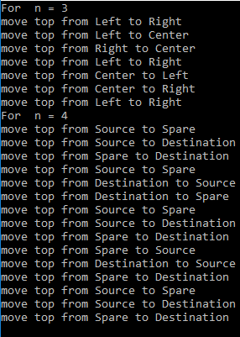
Hanoi Towers Program Output
hanoi(3)
move top from Left to Right
move top from Left to Center
move top from Right to Center
move top from Left to Right
move top from Center to Left
move top from Center to Right
move top from Left to Right

Slide 18
Insertion Sorting : Implemented in the Fantastic Four
1. Formulate the size-n problem.
int* sorting(int *A, int n);
. . .
2. Find the stopping condition and the corresponding return value.
3. Select m, formulate the size-m problem, assume it is sorted.
. . .
x
assume
n- 1
1
. . .
4. Construct the solution of size-n problem.
. . .
<= x
> x
x

Slide 19
Insertion Sorting: Applying the Fantastic Four
1. Formulate the size-n problem.
int* sorting(int *A, int n);
2. Find the stopping condition and the corresponding return value.
The stopping condition is n == 1, and the solution or return value is the address of A.
3. Select m and formulate the size-m problem.
We take a simple approach by reducing the size of the problem by one: m = n – 1
The size-(n-1) problem is int *sorting(B, n-1);
where B is the address of an array of size-(n-1). We assume B will be sorted if we call this function. This is very important!
4. Construct the solution of size-n problem.
Since step 3 can solve the size-(n-1) problem, it is then easy to solve the size-n problem:
We split array A into two parts: the sub array of the first n-1 elements is B, and the remaining element is x.
We call the function in step 3 to sort the size-(n-1) array B.
We find the correct position p for inserting x into B.
We make space for x by shifting the elements after position p one place right;
We insert x at the position p.

Slide 20

Insertion Sorting: Implemented in the Fantastic Four
#include <stdio.h>
int* sorting(int *A, int n) { // size-n problem
int *B, i, j, p = n-1, x;
if (n==1) return A; // stopping condition and return value
else {
x = A[n-1]; // Store the last element in x
B = sorting(A, n-1); // size-(n-1) problem
i = 0;
while (i < n-1) { // construct size-n solution
if (x < B[i]) {
p = i; // found the position p for x
i = n; // exit the loop
}
else i++;
} // x should be inserted at position p
for (j = p; j < n-1; j++) // make space
B[n-1-(j-p)] = B[n-1-(j-p)-1];
B[p] = x; // put x in the correct place
return B;
} // end of else branch
}
void main() {
int *SA, k, A[] = {3, 2, 4, 2, 9, 7, 1, 6}; // sample array
k = (int)sizeof(A)/sizeof(int); // get the length of the array
SA = sorting(A, k);
}

Slide 21
Time Complexity of Sorting Algorithms
Sorting Algorithm | Worse-case | Average
Insertion Sort | O(n²) | Slow
Mergesort | O(nlgn) | Fast
Quicksort | O(n²) | Fastest
CSE205 or Read Text Section 2.8
Optional Text Reading:
Section 2.8.4: Insertion Sort
Section 2.8.5: merge Sort
Section 2.8.6: Quick Sort
Section 2.8.7: Gray Code Generation

Slide 22
Graph and Tree
In a linked list, each node has one next-node.
If more than one next node are allowed, the structure is a graph.
A graph is a tree, if it does not contain a loop, and there is no more than one path between any two nodes.
The height (depth) of a tree is the number edges from the root to the deepest (farthest) leaf.
leaves
root
Height → 3

Slide 23
Binary Tree and Binary Search Tree
A tree is a binary tree, if any of its node can have at most two next nodes (child nodes).
In a full binary tree, each node has either no child or two children.
A balanced binary tree is a tree, in which the heights (depths) of any two leave nodes never differ by more than 1. For a n-node tree, its height is O(lg n) + 1

Slide 24
Binary Search Tree
root
root
root
10
8
15
5
14
17
2
7
12
11
A tree
A binary tree
A binary search tree

Slide 25
Traversing a Binary Search Tree
7
5
5
8
2
5
5
6
9
6
5
9
Preorder: root - left subtree - right subtree 7 5 5 6 8 9 5 2 5 6 5 9
Inorder: left subtree - root - right subtree 5 5 6 7 8 9 2 5 5 5 6 9
Postorder: left subtree - right subtree - root 5 6 5 9 8 7 2 5 9 6 5 5

Slide 26
Insertion Algorithm & Complexity of Binary Search Tree
The simplest insertion algorithm:
First number as root;
A smaller number goes to left subtree;
A larger number goes to right subtree.
root
10
In the worst case, when the input numbers are sorted, the tree becomes a linked list.
8
15
5
14
17
A typical scenario is:
2
7
13
The complexity of this insertion algorithm is the order of O(n).
12
The complexity of search algorithm for an arbitrary tree is O(n).
11

Slide 27
Restructure the tree during insertion to make it balanced
Data search is more often than insertion. Thus, search speed is more important.
root
root
10
11
Insertion takes longer
8
15
7
15
5
14
17
5
10
13
17
2
7
13
2
8
12
14
12
The complexity of search algorithm for a balanced binary search tree is O(lg n).
11

Slide 28

Search Algorithm Complexity Summary
Linear search complexity O(n): for data stored in arrays or linked lists
Binary search complexity O(lgn) if the binary tree is balanced.
If the binary search tree can be arbitrary, it could be a linked list. Thus, the complexity is O(n).
To improve search speed:
Make the tree balanced. It requires restructuring the tree when inserting: Red-Black tree in CSE310
Allow more children: The best performance for a k-ary search tree is O(log_{k}n):
BigTable

Slide 29
Data Structure for Binary Search Trees
A tree node is defined by an object of at least three fields:
struct treeNode {
int data; // also called key
struct treeNode *left, *right; // pointers to treeNode
}
root
left
data
right
left
data
right
left
data
right

Slide 30
Tree Traversing Algorithms
inorderTraverse(p) // size-n problem
if p ≠ 0 then // Stopping and ret
inorderTraverse(p->left); // size-m problem
print(p->data);
inorderTraverse(p->right); // size-m problem
Size-m to size-n solution
preorderTraverse(p) // size-n problem
if p ≠ 0 then // Stopping and ret
print(p->data); preorderTraverse(p->left); // size-m problem
preorderTraverse(p->right); // size-m problem
Size-m to size-n solution
Tree postorderTraverse(p): print after recursive calls
Linked list: preorder: print forward
postorder: print backward
Homework 7-8

Slide 31
Binary Search Tree Example: Declaration
#include <stdio.h>
#include <string.h>
#include <stdlib.h> // used by malloc
#include <time.h>
struct treeNode
{
int data;
struct treeNode *left, *right; // pointers to left and right
} *root = 0; //root is a global pointer to the root entry
void branching(char); // function forward declaration
void insertion();
struct treeNode *search(struct treeNode *, int);
void traverse(struct treeNode *);

Slide 32
Binary Search Tree Example: main()
main( ) { // print a menu for selection
char ch = 'i';
srand( (unsigned)time( 0 ) ); // Use current time as seed
while (ch != 'q') {
printf("Enter your selection\n");
printf(" i: insert a new entry\n");
printf(" s: search an entry\n");
printf(" t: traverse the tree and print\n");
printf(" q: quit \n");
fflush(stdin); // flush the input buffer
ch = tolower(getchar());
branching(ch);
}
}

Slide 33
Binary Search Tree Example: branch()
void branching(char c) { // branch to different tasks
int key;
switch(c) {
case 'i':
insertion(); // Not passing root, but use it as global
break;
case 's':
printf("Enter the key to search\n");
scanf("%d", &key);
search(root, key); // root call-by-value
break;
case 't':
traverse(root); // print all data
break;
default:
printf("Invalid input\n");
}
}

Slide 34
Binary Search Tree Example: search()
struct treeNode * search(struct treeNode *top, int key) { // print data and email
struct treeNode *p = top;
if (key == p->data)
printf("data = %d\n", p->data);
if (key <= p->data) {
if (p->left == 0) return p;
else search(p->left, key);
}
else {
if (p->right == 0) return p;
else search(p->right, key);
}
return p;
}
15
top
p
10
top
8
16
5
14
17
2
7
12
13

Slide 35
Binary Search Tree Example: insertion()
void insertion() { // insert a new entry
struct treeNode *p, *q;
int i, n, key;
printf("Enter the number of entries you want to insert\n");
scanf("%d", &n);
for (i=0; i<n; i++) {
p = (struct treeNode *) malloc(sizeof(struct treeNode));
if (p == 0) printf("out of memory\n");
key = rand() %100; // a random key
p->data = key;
p->left = 0; p->right = 0;
if (root == 0) root = p; // tree empty
else {
q = search(root, key);
if (key < q->data) q->left = p;
else q->right = p;
} } }
p
15
16
14
17
12
13

Slide 36
What is the complexity of the insertion() function?
For inserting one number?
O(1)
O(lgn) or O(log₂n)
O(n)
O(n²)
For inserting n numbers?
O(1)
O(lgn) or O(log₂n)
O(n)
O(n²)

Slide 37
Binary Search Tree Example: traverse()
void traverse(struct treeNode *top) {
struct treeNode *p = top;
if (p != 0) {
traverse(p->left);
printf("data = %d\n", p->data);
traverse(p->right);
}
}
top
p
10
8
15
5
14
17
2
7
12
13

Slide 38
Binary Search Tree Example: Printout
Enter your selection
i: insert a new entry
s: search an entry
t: traverse the tree and print
q: quit
i
Enter the number of entries you want to insert
6
// Six entries will be inserted here, but invisible
Enter your selection
i: insert a new entry
s: search an entry
t: traverse the tree and print
q: quit
t
data = 5
data = 24
data = 34
data = 48
data = 80
data = 83
Enter your selection
i: insert a new entry
s: search an entry
t: traverse the tree and print
q: quit
i
Enter the number of entries you want to insert
10
// 10entries will be inserted here, but invisible
enter your selection
i: insert a new entry
s: search an entry
t: traverse the tree and print
q: quit
t
data = 5
data = 6
data = 24
data = 34
data = 39
data = 48
data = 80
data = 82
data = 83
data = 93
Enter your selection
i: insert a new entry
s: search an entry
t: traverse the tree and print
q: quit
q

Slide 39
Industry Application
BigTable

Slide 40
BigTable
http://en.wikipedia.org/wiki/BigTable
BigTable supports a fast and extremely large-scale database management system;
It is built on Google File System (GFS);
The idea is similar to the B+ Tree that allows for efficient insertion, retrieval and removal of nodes;
It sorts data when storing them;
It is an extended Binary Search Tree;
It is called B+ Tree

Slide 41
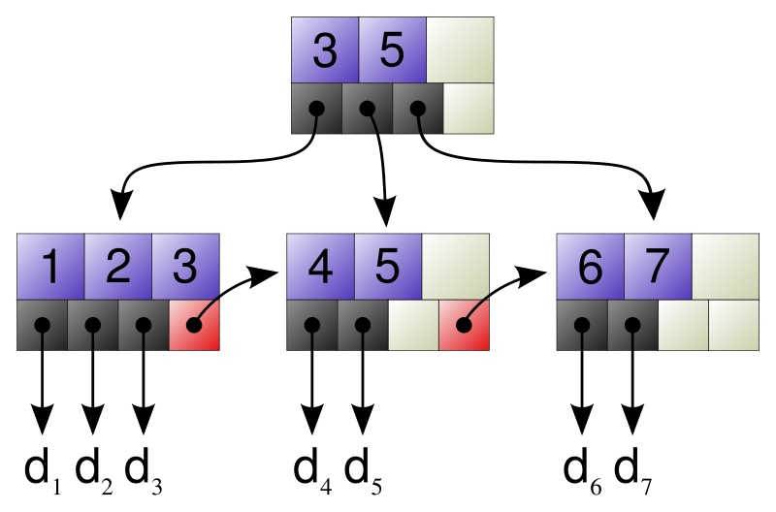
B+ Tree
http://en.wikipedia.org/wiki/B%2B_tree
It is s tree representing sorted data in a way that allows for efficient insertion, retrieval and removal of records, each of which is identified by a key.
It has a dynamic, multilevel index, with maximum and minimum bounds on the number of keys in each index node.
In a B+ tree, in contrast to a B-tree, all records are stored at the lowest level (leaves) of the tree. Only keys are stored in interior blocks

Slide 42
B+ Tree based BigTable
Root Index
•
12
•
31
•
35
•
47
•
Level Two Index
•
2
•
5
•
9
•
•
•
20
•
21
•
26
•
30
•
•
32
•
36
•
•
•
•
Google File System (GFS)
d₁
d₂
d₃
d₄
d₅
d₆
d₇
d₈
d₉
d_{n}

Slide 43
Modules and Packages
Why? Need to group programs in larger units than functions/procedures; Want to group both functions and data.
Conceptual reasons (data abstraction)
Sharing (library functions)
Separate compilations (maintenance issue)
A module usually consists of
Specification: says what the module does; gives external view (in Java term: interface, in C: header);
Implementation part: implement the specification.
Both variables (constants) and function headers (forward declarations) can be listed in specification, which then will be available to all the programs that use the module (library)

Slide 44
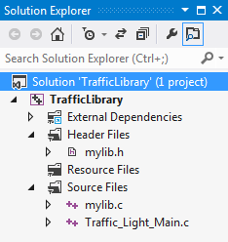
Modules and Packages in Different Languages
Examples:
C has: .h (specification) and .c files (implementation)
Pascal/Modula-2: modules
Java: interfaces and packages
Place .h file and .c file in the same directory in Unix
To define a module and use it in C in Visual Studio
Add a c file into the project stack and name it, e.g., mylib.c
Place all the global functions and global variables that may be used later again in this mylib.c file
Add a header file, mylib.h in to the project stack. This file will list “header” of each function (forward declaration) and the variables that need to be shared.
Can also create pre-compiled DLL library function

Slide 45
Define Your Own Library Example: Text Section 2.8
typedef enum {red, amber, green} traffic_light;
void sleep(int wait);
double cylinder (int h, int r);
// file name: mylib.c
#include<time.h>
const float pi = 3.14159265;
void sleep(int wait) {
clock_t goal;
goal = wait * CLOCKS_PER_SEC + clock();
while( goal > clock() ) { };
}
double cylinder (int h, int r) { //h: height, r: radius
const double pi = 3.14159265;
return pi*r*r*h;
} // Add any functions that you want to add
What is it?
What is it?
#include <stdio.h> // system library uses angle brackets to include
#include "mylib.h" // user library uses quotes to include
main() {
traffic_light x = red;
printf("Red:\tStop!\n");
while (1)
switch (x) {
case amber: sleep(1); x = red; printf("Red:\tStop!\n"); break;
case red: sleep(6); x = green; printf("Green:\tGo>>>\n"); break;
case green: sleep(12); x = amber; printf("Amber:\tBrake...\n");
}
}
#include "mylib.h"
The reason is for compiler to search the user directory

Slide 46
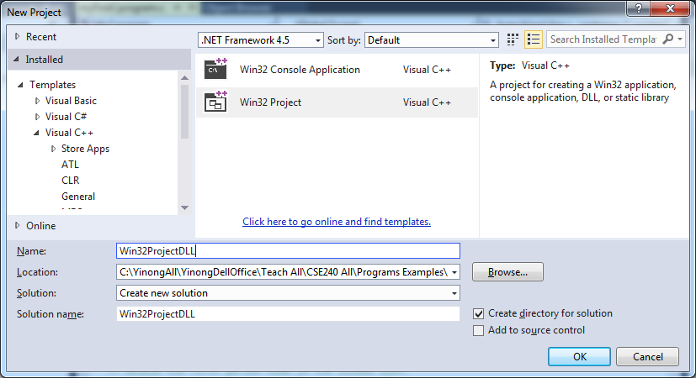
Creating Pre-Compiled DLL Library 1
Dynamic-Link Library (DLL): is a module that contains functions and data that can be “included” by another module (application or DLL).
You can share a DLL library with others without sharing the source code

Slide 47
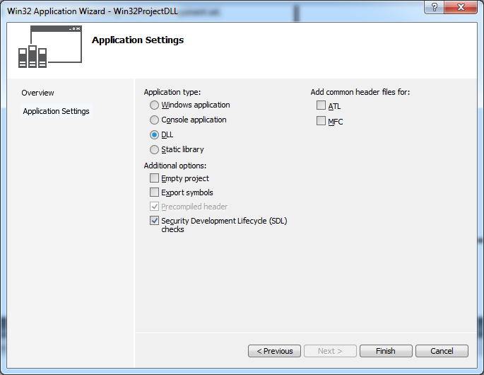
Creating Pre-Compiled DLL Library 2

Slide 48
Modules and Packages: Scope and Visibility
Within a module, the usual scope rules apply.
Global variables given in the module specification (e.g., .h file in C) are in the scope of any program unit that uses it. Memory is allocated statically, so it exists for the duration of the program.
Global variables within the implementation of the module are statically allocated --- they exist for the duration of the module execution. However, they may not be directly accessible and visible. They are invisible inside a function if the same name is used by a local variable. In this case, one can use this.variable to differentiate global and local variables.

Slide 49
Summary: Data Types and Data Structures
We focused on issues that are different from Java:
Data types, variable declaration and scope
Constants can be defined by const, macro and enum
Arrays and strings (there is no string type in C)
Pointers and strings
Files
How to define your own data types and data Structures
enum type
struct type
combination of pointer, array and struct
Dynamic Arrays
One dimensional
Two dimensional
Linked list
Tree
Stack (used in function calls to save the register variables)

Slide 50
Summary: Programming Techniques
Manipulation of data and data structures
Manipulation of primitive data types
Manipulation of arrays and pointers and their combinations
Manipulation of files
Large examples of array, pointer, and structures
Arrays: static in size, memory used for data only
Linked list: store a pointer, in addition to data
Binary tree: store two pointers, in addition to data.
Functions: calling and parameter passing
Call-by-value
Call-by-alias
Call-by-address
Recursive manipulation of data: The Fantastic Four Steps
Modules and packages

Slide 51
Summary: Compare and Contrast C/C++ and Java
Feature | C or C++ | Java
Macro | YES | NO
inlining | YES | YES
Global variables | YES | NO
Static variables | YES | YES
Pointer | YES | NO (ref)
Value semantics for all types | YES | Primitive types
Reference semantics for all types | YES | Reference types
string type | char array | YES
union type | YES | NO
Parameter passing: call-by-value | YES | Primitive types
Parameter passing: call-by-alias | C++ only | NO
Parameter passing: call-by-address | YES | Reference types
Recursive call and application of the fantastic four abstract approach | YES | YES

Slide 52
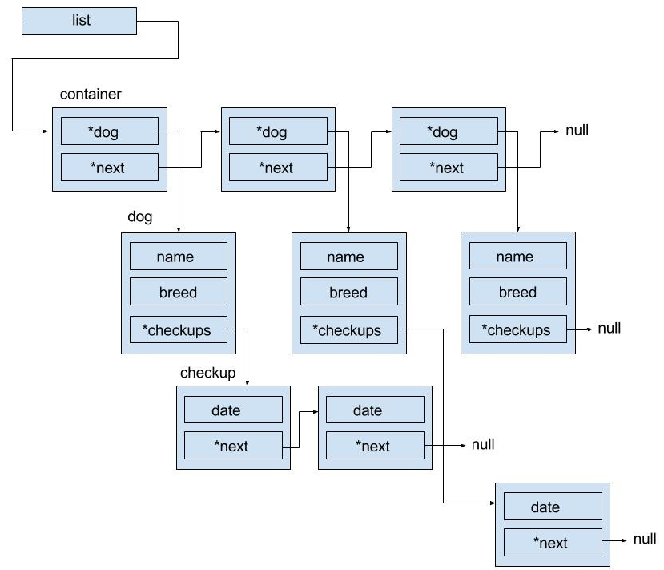
Complex Linked List
The members of dog is in a separate node
The pointer checkups in each dog node is the “head pointer” the checkup link list.
What do we need to do if we want to delete the container linked list?

Slide 53
What is a Program?
Program
Algorithm
Data
Data
Process (steps) of data manipulation
Objects of the manipulation
Emphasis:
Imperative
Procedural Paradigms
Emphasis:
Object-Oriented Paradigm
This chapter
Next chapter

